Slide 1


MD FAKRUL ISLAM(613839) BIG DATA TECHNOLOGY
https://github.com/aifakrul/BigDataTechnology-CSE522

Slide 2
Twitter Spark Streaming – 1st Exercise https://github.com/aifakrul/BigDataTechnology-CSE522/tree/main/SparkStreaming
I will show how to build a simple application that reads online streams from Twitter using Python, then processes the tweets using Apache Spark Streaming to identify hashtags.

Slide 3
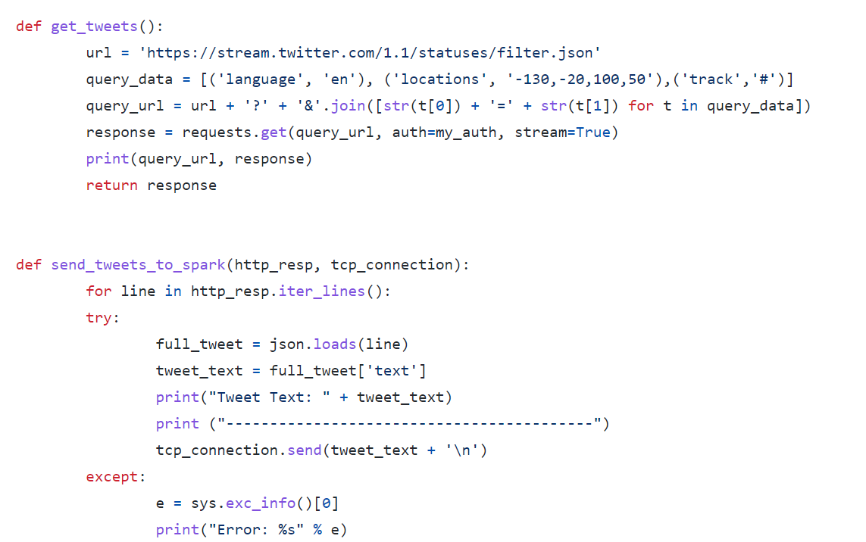
Building the Twitter HTTP Client and Spark Streaming to process

Slide 4
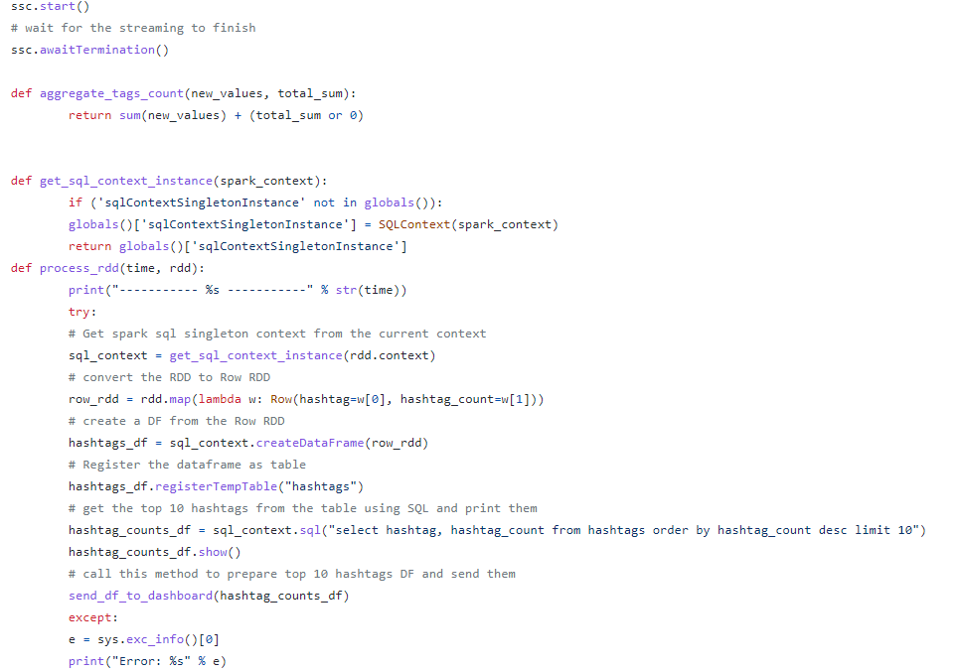
SPARK PROCESSING

Slide 5
Twitter KAFKA SPARK HIVE Streaming – Second Exercise https://github.com/aifakrul/BigDataTechnology-CSE522/tree/main/KafkaSparkHiveIntegration
In this example, I will do the below things.
▪ create a stream of tweets that will be sent to a Kafka queue
▪ pull the tweets from the Kafka cluster
▪ calculate the character count and word count for each tweet
▪ save this data to a Hive table

Slide 6

1.VM setup in my azure account
2.Install Kafka
3.Install Hadoop
4.Install Hive
5.Install Spark

Slide 7
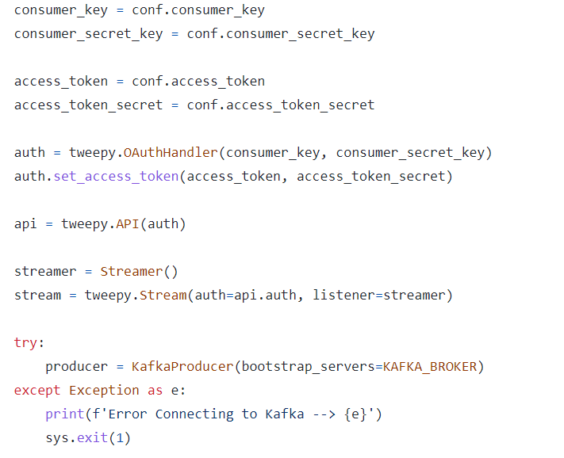
KAFKA BROKER - PRODUCER

Slide 8
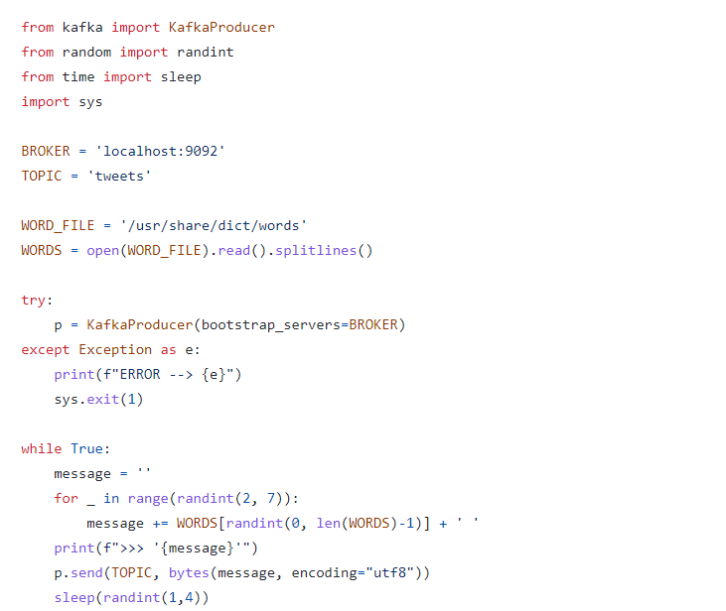
Fake Tweet Stream To KAFKA

Slide 9
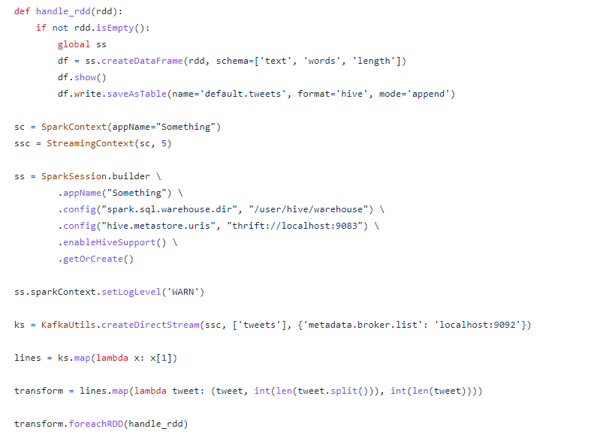
SPARK PROCESSING – HIVE STORING

Slide 10
SparkML using pyspark for Regression – Third Exercise https://github.com/aifakrul/BigDataTechnology-CSE522/tree/main/ResearchProject
The goal of this exercise is predicting the housing prices by the given features. Let's predict the prices of the Boston Housing dataset by considering MEDV as the output variable and all the other variables as input. The whole exercise is done in Google Collab

Slide 11
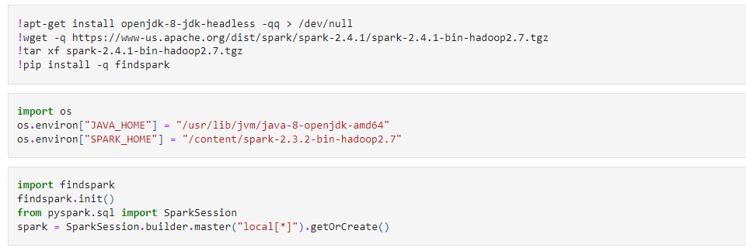
INSTALL ALL LIBRARIES IN COLAB

Slide 12
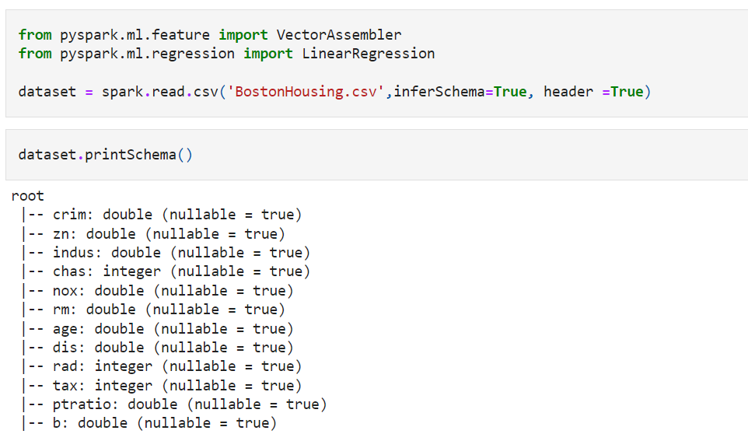
LOAD BOSTON HOUSING DATASET

Slide 13
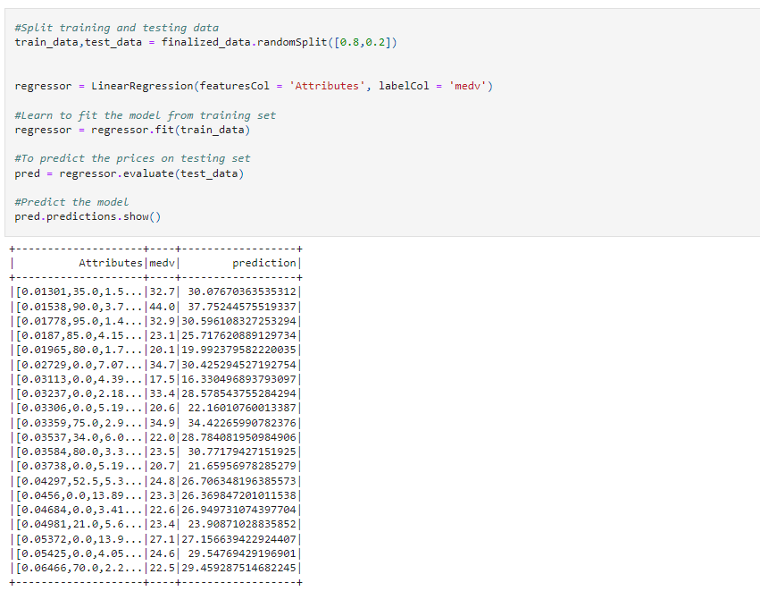
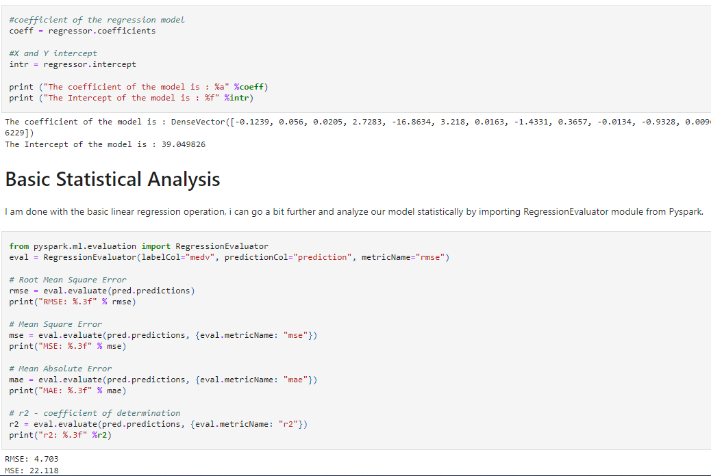
DRIVE REGRESSION FOR PREDICTION

Slide 14
THANK YOU

